Slide 1
Flow Sensors

Slide 2
Ultrasonic Flow Sensors

Slide 3
Ultrasonic Flow Sensors
Ultrasonic flowmeters use sound waves to determine the velocity of a fluid flowing in a pipe.
At no flow conditions, the frequencies of an ultrasonic wave transmitted into a pipe and its reflections from the fluid are the same.
Under flowing conditions, the frequency of the reflected wave is different due to the Doppler effect.
When the fluid moves faster, the frequency shift increases linearly.
The transmitter processes signals from the transmitted wave and its reflections to determine the flow rate.

Slide 4
Ultrasonic Flow Sensors
Transit time ultrasonic flowmeters send and receive ultrasonic waves between transducers in both the upstream and downstream directions in the pipe.
At no flow conditions, it takes the same time to travel upstream and downstream between the transducers.
Under flowing conditions, the upstream wave will travel slower and take more time than the (faster) downstream wave.
When the fluid moves faster, the difference between the upstream and downstream times increases.
The transmitter processes upstream and downstream times to determine the flow rate.

Slide 5
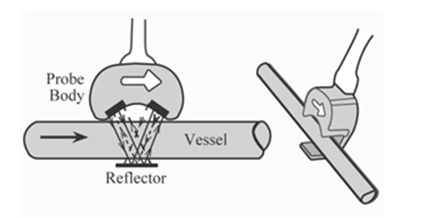
Ultrasonic Flow Sensors

Slide 6
Advantages of Ultrasonic Flow Sensors
This technology can be very accurate
Is used for custody transfer (meaning accounting accurately for an expensive fluid) of natural gas and petroleum liquids.
High turndown (can read low as a percentage of the full scale or top reading),
Handles high pressures.
It is repeatable (consistent).
Handles extreme temperatures.
Can be used clamped to the outside of a pipe without penetration
Has low maintenance.
Highly reliable
Self –diagnosing.
No risk of leakage

Slide 7
Disadvantages of Ultrasonic Flow Sensors
It is expensive as compared with other mechanical flow meters
Sensitivity to stray process vibrations.
Problems with pipe diameter change.
Due to buildup and clamp-on units have lower accuracy.
Design of this meter is complex.

Slide 8
Applications of Ultrasonic Flow Sensors
These meters are used in wastewater and dirty liquid applications
Ultrasonic flowmeters do not obstruct flow so they can be applied to sanitary, corrosive and abrasive liquids.
Clamp-on transducers are especially useful when piping cannot be disturbed, such as in power and nuclear industry applications.
In addition, clamp-on transducers can be used to measure flow without regard to materials of construction, corrosion, and abrasion issues.
Ultrasonic flowmeters are commonly applied to measure the velocity of liquids that allow ultrasonic waves to pass, such as water, molten Sulphur, cryogenic liquids, and chemicals.
They are used to measure gas and vapor flow.
Also Measures Oil and gas, water and wastewater, power, chemical, food and beverage, pharmaceutical, metals and mining, and pulp and paper.

Slide 9
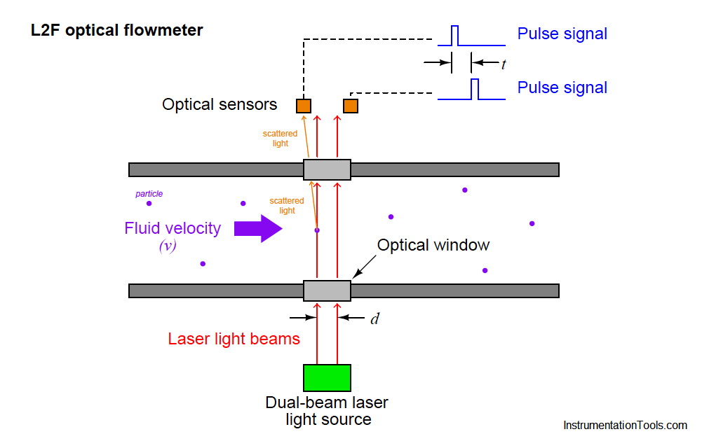

Laser Flow Sensors

Slide 10
Laser Flow Sensors
Where, v = Velocity of particle d = Distance separating laser beams t = Time difference between sensor pulses

Slide 11
Laser Flow Sensors
The LaserFlow velocity sensor remotely measures flow in open channels with non-contact Laser Doppler Velocity technology.
The sensor then focuses its laser beam at this point and measures the frequency shift of the returned light.

